Slide 1

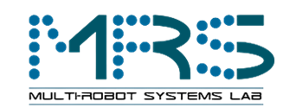
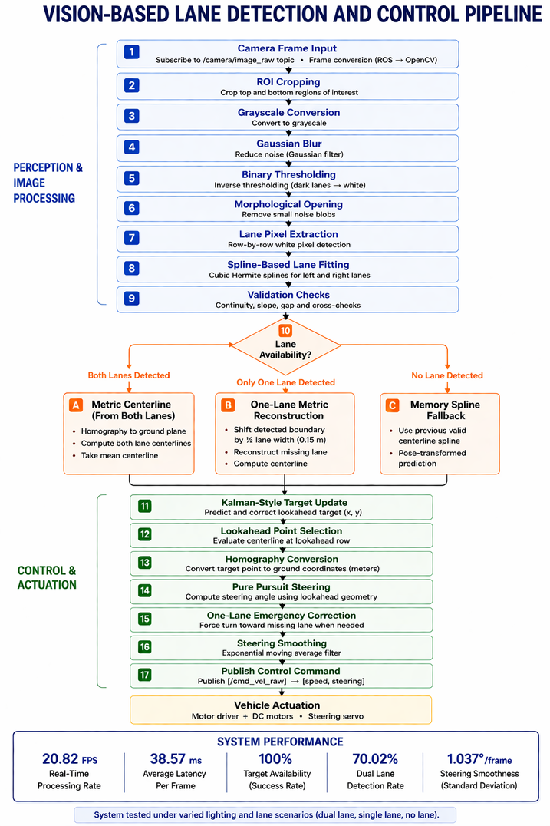

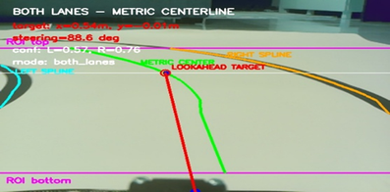
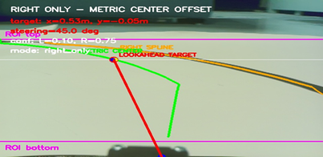





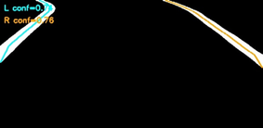
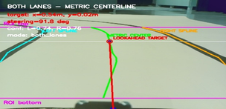

VISION-BASED LANE DETECTION AND CONTROL FOR AUTONOMOUS VEHICLES
Image Processing for Mechatronics MCTR1010
SPRING 2026
Youssef Mohamed 55-1031 ,Somaya Magdy 55-5027 ,Bassam Walid 55-0499 ,Styven Hany 55-10067,Mostafa Shakweer 56-29282 ,Hassan Yasser 55-26164
youssef.abodeb,somaya.kilany,bassam.aboelhamaid,styven.ghaly,mostafa.shakweer,hassan.yasser@student.guc.edu.eg
Course Instructors: Assoc. Prof. Dr. Eng. Omar M. Shehata, Eng. Dalia M. Mahfouz, PhD, Eng. Abdelrahman Hatem, MSc. And Eng. Mohammed Ashraf
Abstract
Results
This project presents a real-time vision-based lane detection and autonomous navigation system for a mobile robot. A Raspberry Pi processes camera images using ROI extraction, thresholding, and spline-based lane modeling to detect lane boundaries and estimate the lane center. A homography transformation enables metric-based perception, while a Pure Pursuit controller generates steering commands based on lateral error. The system operates in real time at 20.82 FPS, achieving 100% target availability and stable lane-following performance. Results demonstrate robustness under varying conditions, with limitations related to lighting sensitivity and camera calibration.
Metric | Value
FPS | 20.82
Processing Latency | 38.57 ms
Target Availability | 100%
Dual Lane Detection | 70.02%
Steering Smoothness | 1.037°/frame
Methodology
Real-time performance with low latency and stable control. Robust operation under dual and single-lane conditions.
System Architecture
Camera
Raspberry pi
Arduino
Motors
The system captures real-time images using a front-mounted camera. The Raspberry Pi processes the images to detect lane boundaries and compute steering commands. These commands are transmitted to an Arduino, which controls the motors and steering servo to achieve autonomous lane following.
Dual Lane Output
Single Lane Output
Image Processing Pipeline Outputs
Scan for Live Demo
Scan for full report.
Conclusion
  Real-time lane following achieved (20.82 FPS)
  100% target availability
  Robust under multiple scenarios
  Limited by lighting and calibration
Raw ROI
Threshold
Morphological Output
Spline Fit
Final Output
Pipeline illustrating transformation from raw input to final lane detection output.

